Slide 1
Medicare 101
Y0071_15_24195_I_002 05/04/2015
51480MUSENMUB_002 REV 11/2018

Slide 2
Getting Started
Basic information about:
  Medicare
  The Health Insurance Marketplace
Resources to help with Medicare decisions:
  Choosing medical and prescription drug coverage
  Timing:
  To ensure coverage
  To avoid penalties

Slide 3
Basic Medicare Information
What is Medicare?
A health insurance program for people:
  Who are 65 and older.
  Under 65 with certain disabilities.
  Any age with end-stage renal disease (ESRD).

Slide 4
Basic Medicare Information
Who runs Medicare?
  Centers for Medicare & Medicaid Services (CMS)
  – Administers program
  Social Security Administration (SSA)
  – Enrolls most individuals
  – Railroad Retirement Board (RRB) enrolls
  railroad retirees
4

Slide 5
Basic Medicare Information
Medicare has four parts:
Original Medicare: Part A and Part B
Part C
Part D – prescription drug coverage

Slide 6
Resources to Help with Medicare Decision
Step 1: Decide how you want to get your Medicare coverage
Original Medicare Plan
Or
Medicare Advantage (MA) Plans
Part A
Inpatient Hospital
Part B
Medical
Part C
Combines Parts A & B, and usually Part D
Step 2: Decide if you need to add drug coverage.
Step 2: Decide if you need to add drug coverage.
Part D
Part D
Prescription Drug Coverage
(Most MA plans cover prescription drugs.
You may be able to add drug coverage in some plan types if not already included.)
Prescription Drug Coverage
Step 3: Decide if you need to add supplement coverage
Medicare Supplement Insurance (Medigap) policy
End
End
If you join a Medicare Advantage plan, you can’t use and be sold a Medicare Supplement Insurance (Medigap) policy.

Slide 7
When can
you enroll in
Original Medicare?

Slide 8

Enrolling in Medicare
Automatic enrollment if you receive:
  Social Security benefits
  Railroad Retirement Board (RRB) benefits
Initial enrollment period package:
  Mailed three months before age 65, or
  25th month of disability benefits
  Includes your Medicare card

Slide 9
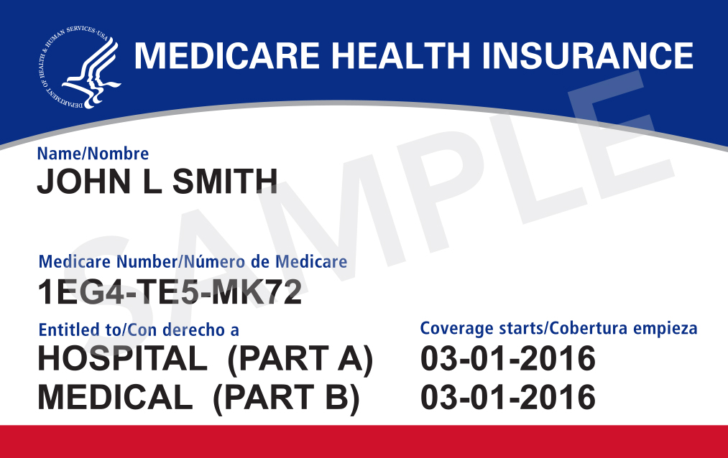
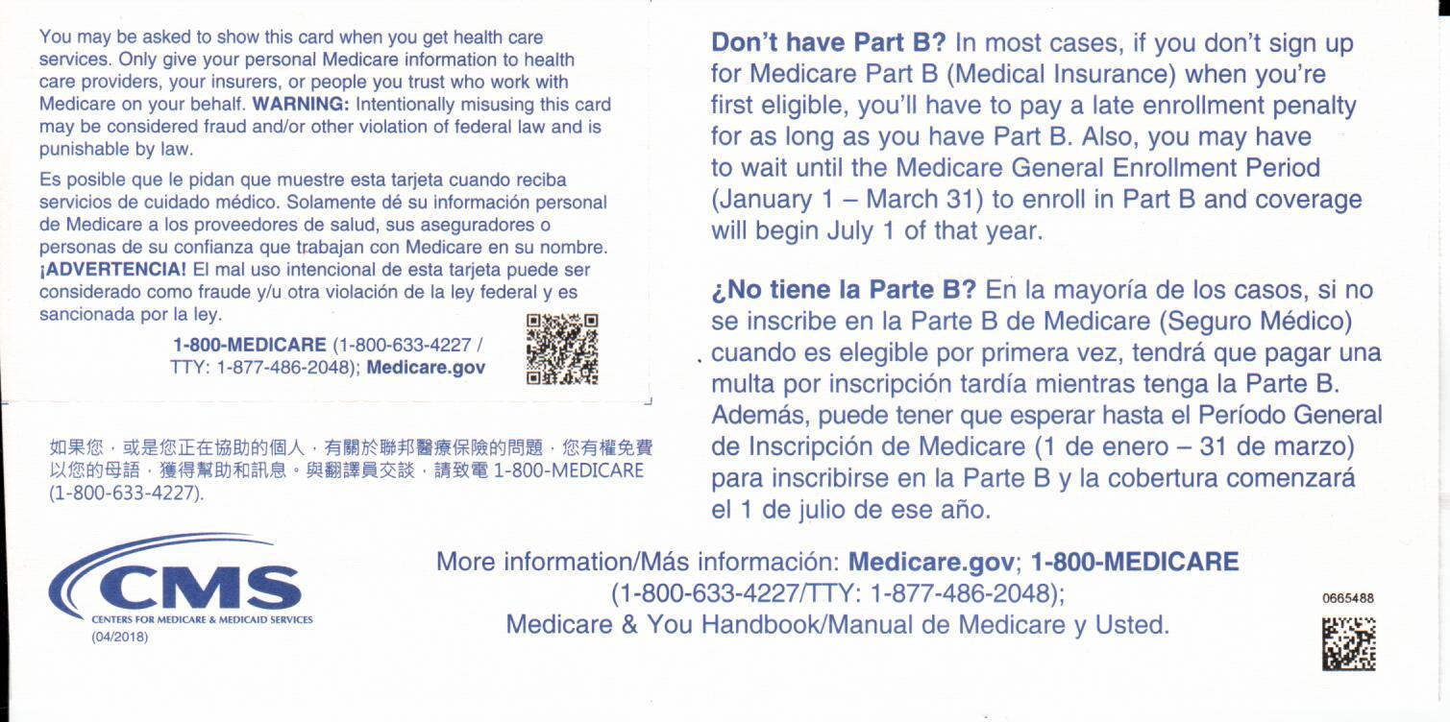
Medicare Card
  Keep it and accept Medicare Part A and Part B
  Return it to refuse Part B (follow instructions on back of card)
Front
Back

Slide 10
How to Enroll in Medicare
If enrollment isn’t automatic (for instance, if you’re still actively working, you need to enroll with Social Security by doing one of the following):
  Visit your local office, or
  Call 1-800-772-1213, or
  Visit www.socialsecurity.gov
If you’re a railroad retiree, you may enroll with Railroad Retirement Board (RRB):
  Call your local RRB office, or
  Call 1-877-772-5772

Slide 11
When to Enroll in Medicare
You don’t have to be retired.
Your initial enrollment period (IEP) lasts seven months.
  Begins three months before your 65th birthday
  Includes the month you turn 65
  Ends three months after you turn 65
There are other times you may enroll.
  But you may pay a penalty if you delay.

Slide 12

Deciding what plan best fits you:
Original Medicare or Medicare Advantage?

Slide 13

Medicare Decisions
  Original Medicare or Medicare Advantage?
  Should I take Part B? When?
  What about Part D?
  Do I need a Medicare Supplement
  Insurance (Medigap) policy?
?
✓

Slide 14
Original Medicare Overview
Medicare Part A helps cover costs for:
  Hospital stays.
  Skilled nursing facility care.
  Hospice care.
  Some home health care.
Medicare Part B helps cover costs for:
  Doctors’ services.
  Outpatient medical and surgical services, supplies.
  Clinical lab tests.
  Durable medical equipment.
  Preventive services.

Slide 15
Paying for Medicare Part A
(Hospital Insurance)
What does Part A cost?
Most people get Part A premium free if:
  You or your spouse paid FICA taxes at least 10 years.
  You paid FICA less than 10 years, you:
    Can pay a premium to get Part A.
    May have a penalty,
      if not bought when first eligible.

Slide 16
What You Pay for Inpatient Hospital Stays
For each benefit period in 2019 | You pay
Days 1-60 | $1,364 deductible
Days 61-90 | $341 per day
Days 91-150 | $682 per day (60 lifetime reserve days)
All days after 150 | All costs

Slide 17
What You Pay for Skilled Nursing
Facility Care
For each benefit period in 2019 | You pay
Days 1-20 | $0
Days 21-100 | $170.50 per day
All days after 100 | All costs

Slide 18
Decision: Do I Need to Sign Up for Part A?
Consider:
  You get it automatically if getting Social Security/RRB.
  It’s premium free for most people.
  You can pay for it if work history isn’t sufficient.
    There may be a penalty if you delay.
  If you or your spouse is actively working and covered by an employer plan.
    – Contact Social Security to sign up.
Maybe not if you have a Health Savings Account
Notes:
In most cases you get Part A automatically, but if not, you should consider signing up for Part A if you’re eligible to get it premium-free. You usually don’t pay a monthly premium for Part A coverage if you or your spouse paid Medicare taxes while working.
If you aren’t eligible for premium-free Part A, you may be able to buy Part A if:
You’re 65 or older, and you have (or are enrolling in) Part B and meet the citizenship and residency requirements.
You’re under 65, disabled, and your premium-free Part A coverage ended because you returned to work.
If you aren’t eligible for premium-free Part A, and you don’t buy it when you’re first eligible, your monthly premium may go up 10%. You’ll have to pay the higher premium for twice the number of years you could have had Part A, but didn’t sign up. The 10% premium surcharge will apply only after 12 months have elapsed from the last day of the IEP to the last date of the enrollment period you used to enroll. In other words, if it is less than 12 months, the penalty won’t apply. This penalty won’t apply to you if you're eligible for a Special Enrollment Period. You’re eligible for a Special Enrollment Period if you or your spouse (or family member if you’re disabled) is working, and covered by a group health plan through the employer or union based on that work, or during the 8-month period that begins the month after the employment ends or the group health plan coverage ends, whichever happens first.
You may want to delay enrolling in Part A if you continue to work and want to continue to contribute to your Health Savings Account (HSA). Once you enroll in Medicare you can no longer contribute to your HSA. See IRS Publication 969 for more information. irs.gov/pub/irs-pdf/p969.pdf

Slide 19
What You Pay for Part B
If your yearly income in 2017 (for what you pay in 2019) was |  |  | You pay each month (in 2019)
File individual tax return | File joint tax return | File married & separate tax return
$85,000 or less | $170,000 or less | $85,000 or less | $135.50
above $85,000 up to $107,000 | above $170,000 up to $214,000 | Not applicable | $189.60
above $107,000 up to $133,500 | above $214,000 up to $267,000 | Not applicable | $270.90
above $133,500 up to $160,000 | above $267,000 up to $320,000 | Not applicable | $352.20
above $160,000 and less than $500,000 | above $320,000 and less than $750,000 | above $85,000 and less than $415,000 | $433.40
$500,000 or above | $750,000 and above | $415,000 and above | $460.50
Note: Premiums are usually deducted from your Social Security benefit payment.

Slide 20
Paying for Medicare Part B (Medical Insurance)
In Original Medicare you pay:
  Yearly deductible of $185 in 2019.
  20% coinsurance for most services.
Programs may help pay these costs if you have limited income and resources.

Slide 21
Decision: Should I Keep/Sign
Up for Part B?
Consider:
  It’s automatic if you get Social Security/RRB benefits.
  Most people pay a monthly premium.
    Usually deducted from SSA/RRB benefits
    Amount depends on income
  It may supplement employer coverage.

Slide 22
Decision: Should I Keep/Sign Up for Part B?
(continued)
Sometimes you must have Part B, if:
  You want to buy a Medigap (Medicare Supplement) policy.
  You want to join a Medicare Advantage plan.
  You're eligible for TRICARE.
  Your employer coverage requires you have it.
    – Talk to your employer’s or union’s benefits administrator.
With Veterans benefits it’s optional:
  But you pay a penalty if you sign up late, or if you don’t sign up during your initial enrollment period.

Slide 23
Decision: Should I Keep/Sign Up for Part B?
(continued)
If you don’t have coverage from active employment
  Delaying Part B may mean:
    – Higher premiums.
    – Paying for all your health care out of pocket.
If you do have coverage through active employment
  You may want to delay Part B.
  No penalty if you enroll while you have coverage or within eight months of losing coverage.

Slide 24
Decision: Should I Join a
Medicare Advantage Plan?
Consider:
  You must have Part A and Part B to join
  Most offer comprehensive coverage
    Including Part D drug coverage
  May require you to use a network
  May need a referral to see a specialist
  You must pay Part B and monthly plan premium*
  Can only join/leave plan during certain periods
  Doesn’t work with Supplement Insurance (Medigap) policies
* If plan has premium.

Slide 25

Medicare Advantage plan Part C

Slide 26
Part C – Medicare Advantage
Health plan options approved by Medicare
  Another way to get Medicare coverage
  Still part of the Medicare program
  Run by private insurers/companies
Medicare pays plan an amount
  For each member’s care
May have to use network doctors or hospitals
Types of plans available may vary
Plans offer more coverage than Original Medicare.

Slide 27
How Part C Works
  Still in Medicare with all rights and protections
  Includes all Original Medicare (Parts A & B) benefits plus some others
  May include Part D prescription drug coverage
  May include extra benefits (such as vision or dental)
  Benefits and cost sharing may be different

Slide 28
When Can I Enroll in an MA Plan?
Initial enrollment period:
  Three months before you turn 65, the month you turn 65 and three months after the month you turn 65
  Must be entitled to Part A and enrolled in Part B, and
  Permanently reside in the plan service area

Slide 29
Election Periods
Annual election period:
  October 15 to December 7 each year
  The period you can enroll in or change your Medicare Advantage (MA) plan. You may also switch to Original Medicare.
  New coverage will begin January 1.
  You can enroll in an MA plan with prescription drug coverage (MAPD), but not a stand-alone MA plan at the same time as a stand-alone Part D plan.

Slide 30
Election Periods
Special enrollment period (SEP):
  A common SEP is for those covered under their employer’s health plans who retire after 65.
  Moving out of the plan’s service area
  Qualifying for additional financial assistance (LIS, Medicaid)

Slide 31
How to Enroll Medicare Advantage Plan
To join:
  Call the plan toll-free number.
  Visit their website.
  Use the Medicare Plan Finder at www.medicare.gov.

Slide 32
Medicare Basics: Part D
  Available for all people with Medicare
  Purchase from private insurers – not the
  government
    Stand-alone prescription drug plan (PDP)
    that covers only drugs
    Can be used with Original Medicare
  Medicare Advantage plans (MAPD)
    Combined plan: drug plan plus medical coverage
  Some employers and unions

Slide 33
How Medicare Part D Works
  It’s optional.
    You can choose a plan and join.
  Plans have formularies.
    Lists of covered drugs
    Must include range of drugs in each category
  You pay the plan a monthly premium.
  You pay deductibles and copayments.
  There is Extra Help to pay Part D costs
    If you have limited income and resources.

Slide 34
Who Can Join Part D?
You must have Part A and/or Part B.
You must live in the plan’s service area.
You can’t live outside the U.S.
You can’t be incarcerated.
You must actively enroll to join.
  In most cases no automatic enrollment

Slide 35
When Can I Enroll in a Part D Plan?
During your seven-month initial enrollment period
During the yearly open enrollment period
  October 15 – December 7 each year
  Coverage begins January 1
May be able to join at other times
  Special enrollment period

Slide 36
Decision: Should I Enroll in a Part D Plan?
Consider:
  Do you have creditable drug coverage?
    Coverage as good as Medicare’s
      For example, through an employer plan
      No penalty if you delay
  Will that coverage end when you retire?
  How much do your current drugs cost?
  What do the premiums cost for Part D plans?
Without creditable coverage
  Later enrollment may mean you pay a penalty

Slide 37
Joining a Part D Plan
To enroll in a Part D plan:
  Enroll at www.medicare.gov.
  Call 1-800-MEDICARE (1-800-633-4227)
  (TTY: 1-877-486-2048).
  Enroll on the plan’s website.
  Call the plan.
  Complete a paper enrollment form.

Slide 38
What Is a Medigap Policy?
Medicare Supplement Insurance policies
  Sold by private companies
  Some plans offer extra benefits like gym memberships and discounts.
Fills gaps in Original Medicare
  Deductibles, coinsurance, copayments
All plans with same letter
  Have same coverage
  Only costs are different

Slide 39
Medigap Plan Types
 | Medicare Supplement Insurance (Medigap) Plans
Medigap Benefits | A | B | C | D | F* | G | K | L | M | N
Part A coinsurance and hospital costs up to an additional 365 days after Medicare benefits are used up | Yes | Yes | Yes | Yes | Yes | Yes | Yes | Yes | Yes | Yes
Part B coinsurance or copayment | Yes | Yes | Yes | Yes | Yes | Yes | 50% | 75% | Yes | Yes***
Blood (first 3 pints) | Yes | Yes | Yes | Yes | Yes | Yes | 50% | 75% | Yes | Yes
Part A hospice care coinsurance or copayment | Yes | Yes | Yes | Yes | Yes | Yes | 50% | 75% | Yes | Yes
Skilled nursing facility care coinsurance | No | No | Yes | Yes | Yes | Yes | 50% | 75% | Yes | Yes
Part A deductible | No | Yes | Yes | Yes | Yes | Yes | 50% | 75% | 50% | Yes
Part B deductible | No | No | Yes | No | Yes | No | No | No | No | No
Part B Excess charge | No | No | No | No | Yes | Yes | No | No | No | No
Foreign travel exchange (up to plan limits) | No | No | 80% | 80% | 80% | 80% | No | No | 80% | 80%
Out-of-pocket limit** | N/A | N/A | N/A | N/A | N/A | N/A | $$5,560 for 2019 | $2,780 for 2019 | N/A | N/
Plan F also offers a high-deductible plan in some states. If you choose this option, this means you must pay for Medicare-covered costs (coinsurance, copay, deductibles) up to the deductible amount of $2,240 in 2018 before your policy pays anything.
** For Plans K and L, after you meet your out-of-pocket yearly limit and your yearly Part B deductible ($183 in 2018), the Medigap plan pays 100% of covered services for the rest of the calendar year.
*** Plan N pays 100% of the Part B coinsurance, except for a copay of up to $20 for some office visits and up to a $50 copayment for emergency room visits that don’t result in an inpatient admission.

Slide 40
Decision: Do I Need a Medigap Policy?
Consider:
  It only works with Original Medicare.
  Do you have other supplemental coverage?
    If so, you might not need Medigap.
  Can you afford Medicare deductibles and copayments?
  What does the monthly Medigap premium cost?

Slide 41
When Is the Best Time to Buy a Medigap Policy?
Consider:
  Your Medigap open enrollment period begins when you're 65 or older AND enrolled in Part B.
    It lasts six months (may vary by state).
    You have protections – companies MUST sell you a plan.
  You can also buy a Medigap policy whenever a company agrees to sell you one.
    If later, there may be restrictions.
Usually during your Medigap open enrollment period

Slide 42
How Do I Find the Right
Medigap Policy for Me?
Compare plans by computer or phone.
  Visit www.medicare.gov.
    Use the Medigap comparison tool.
  Call 1-800-MEDICARE (1-800-633-4227).
    TTY users should call 1-877-486-2048.
  Call your State Health Insurance Assistance Program (SHIP).

Slide 43
Medicare and the Health Insurance Marketplace
  Medicare isn’t part of the marketplace.
  Marketplace doesn’t affect your Medicare choices.
  Medicare’s benefits aren’t changing because of the marketplace.
  If you joined a marketplace plan before you were eligible for Medicare, you can cancel the marketplace plan once Medicare coverage starts.

Slide 44

Help for People with Limited Income and Resources
  Medicare Savings Programs
  Extra Help
44

Slide 45
What Are Medicare Savings Programs?
Help from Medicaid paying Medicare costs
  Pays Medicare premiums
  May pay Medicare deductibles and coinsurance
Income amounts change each year
Some states offer their own programs

Slide 46
Who Can Qualify for
Medicare Savings Program?
Medicare Savings Program | Individual monthly income limit (2018) | Married couple monthly income limit (2018) | Helps pay your
Qualified Medicare Beneficiary | $1,032 | $1,392 | Part A and Part B premiums, and other cost sharing (like deductibles, coinsurance and copays)
Specified Low-Income Medicare Beneficiary | $1,234 | $1,666 | Part B premiums only
Qualifying Individual | $1,386 | $1,872 | Part B premiums only
Qualified Disabled & Working Individuals | $4,132 | $5,572 | Part A premiums only
These amounts may increase in 2019. If your income and resources are slightly higher, you should still apply

Slide 47
What Is Extra Help?
Help paying Part D prescription drug costs
Social Security or state makes determination
You automatically qualify if you get:
  Both Medicare and full Medicaid
  Supplemental Security Income (SSI) only
  Help from Medicare Savings Programs
You or someone on your behalf can apply

Slide 48
What Resources Are Available to Help?
Medicare website
  www.medicare.gov
Social Security website
  www.socialsecurity.gov
Health Insurance Marketplace website
  www.healthcare.gov

Slide 49

Medicare.gov

Slide 50

Medicaid.gov

Slide 51

SocialSecurity.gov

Slide 52
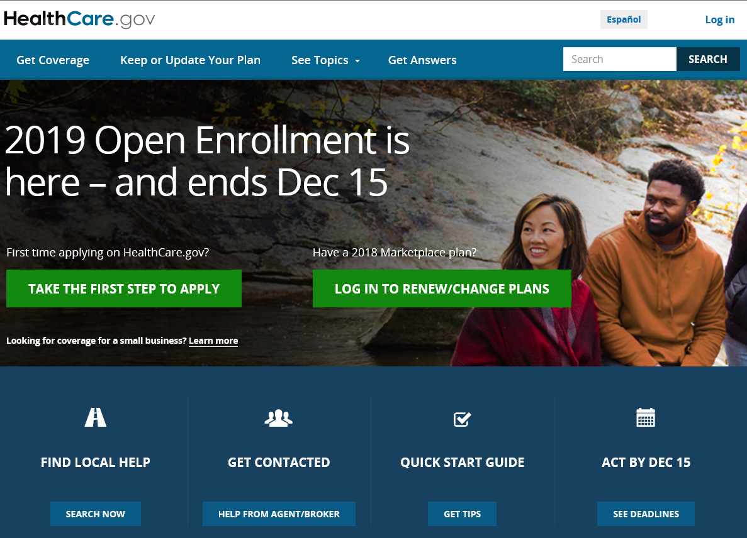
HealthCare.gov

Slide 53
Key Points to Remember
Medicare is a health insurance program.
It doesn’t cover all of your health care costs.
You have choices in how you get coverage.
There are programs for people with limited income and resources.
Important:
  Decisions affect type of coverage you get.
  Certain decisions are time-sensitive.
  Get help if you need it.

Slide 54
Thank you!
Anthem Blue Cross and Blue Shield is the trade name of: In Colorado: Rocky Mountain Hospital and Medical Service, Inc. HMO products underwritten by HMO Colorado, Inc. In Connecticut: Anthem Health Plans, Inc. In Georgia: Blue Cross Blue Shield Healthcare Plan of Georgia, Inc. In Indiana: Anthem Insurance Companies, Inc. In Kentucky: Anthem Health Plans of Kentucky, Inc. In Maine: Anthem Health Plans of Maine, Inc. In Missouri (excluding 30 counties in the Kansas City area): RightCHOICE® Managed Care, Inc. (RIT), Healthy Alliance® Life Insurance Company (HALIC), and HMO Missouri, Inc. RIT and certain affiliates administer non-HMO benefits underwritten by HALIC and HMO benefits underwritten by HMO Missouri, Inc. RIT and certain affiliates only provide administrative services for self-funded plans and do not underwrite benefits. In Nevada: Rocky Mountain Hospital and Medical Service, Inc. HMO products underwritten by HMO Colorado, Inc., dba HMO Nevada. In New Hampshire: Anthem Health Plans of New Hampshire, Inc. HMO plans are administered by Anthem Health Plans of New Hampshire, Inc. and underwritten by Matthew Thornton Health Plan, Inc. In Ohio: Community Insurance Company. In Virginia: Anthem Health Plans of Virginia, Inc. trades as Anthem Blue Cross and Blue Shield in Virginia, and its service area is all of Virginia except for the City of Fairfax, the Town of Vienna, and the area east of State Route 123. In Wisconsin: Blue Cross Blue Shield of Wisconsin (BCBSWI), Compcare Health Services Insurance Corporation (Compcare) and Wisconsin Collaborative Insurance Company (WCIC). BCBSWI underwrites or administers PPO and indemnity policies and underwrites the out-of-network benefits in POS policies offered by Compcare or WCIC; Compcare underwrites or administers HMO or POS policies; WCIC underwrites or administers Well Priority HMO or POS policies. Independent licensees of the Blue Cross Blue Shield Association. Anthem is a registered trademark of Anthem Insurance Companies, Inc.

